Slide 1
cs231n project
Object Tracking
Moshe Karl, July 2019
Advisor: Prof. Tal Hassner

Slide 2
Subject: Object tracking
Single object
Given GT @ frame[0]
Causal
Appearance variations
Hidden Slide

Slide 3
Object tracking benchmarks

Slide 4
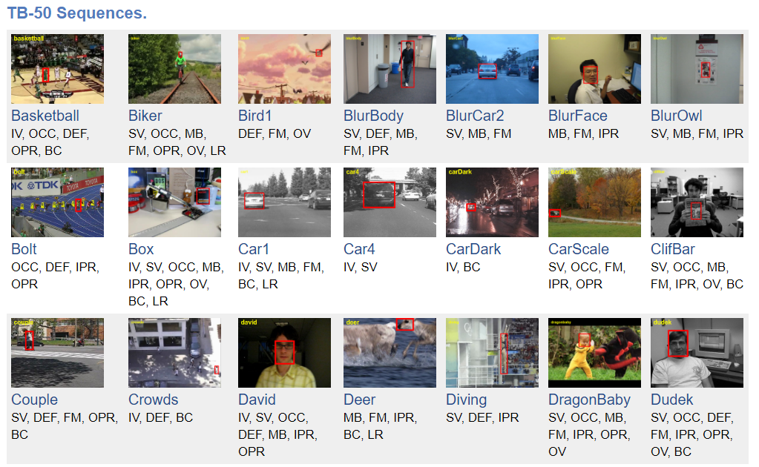
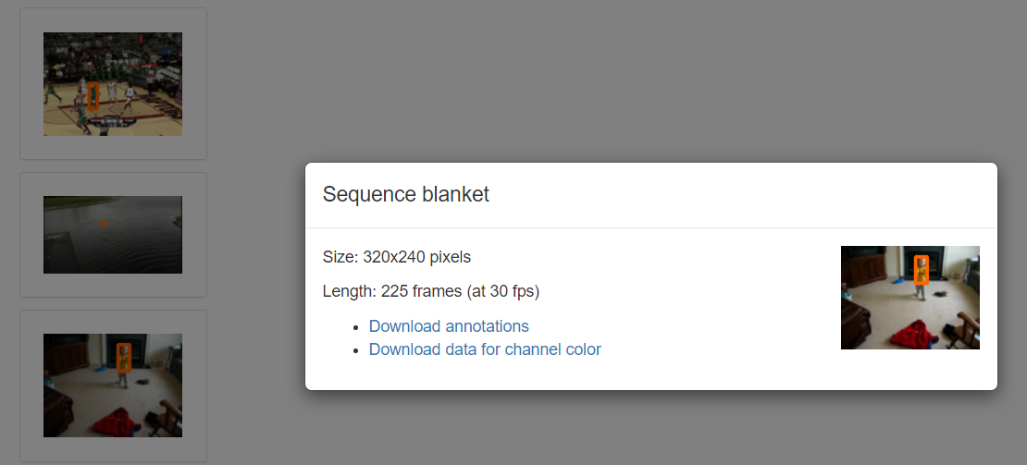
Object tracking benchmarks
VOT (Visual Object Tracking)
OTB (Online Tracking Benchmark)
Notes:
Both have dozens of sequences, ~ hundreds frames per sequence (.jpg images), 30fps
Each frame tagged with bounding box (ground truth), 1st frame GT given to kick off tracking

Slide 5
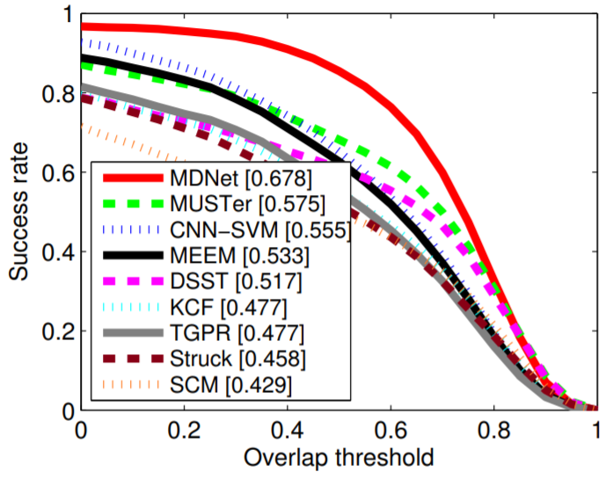
Object tracking benchmarks
OTB
Success plot
OTB 2015
Notes:
success plot (metric)
per-frame: “overlap score” – IoU (with GT)
per-sequence: plot %frames where overlap score > threshold[0,1]
per-sequence: “average overlap score” (over frames), aka “area under curve”
Note: for zero threshold, none of the models start at success rate of 1
The reason is that for some frames the IoU is absolute zero.
Plot taken from https://www.cv-foundation.org/openaccess/content_cvpr_2016/papers/Nam_Learning_Multi-Domain_Convolutional_CVPR_2016_paper.pdf
Very similar plot can be found also here https://zhouyzzz.github.io/otb-toolkit/

Slide 6
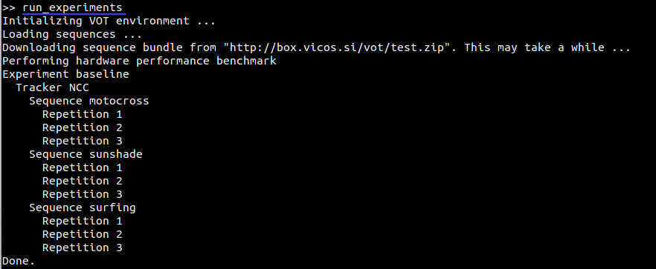
Object tracking benchmarks
Toolkits
Notes:
Official (MATLAB) toolkits available online for each benchmark separately
I did not use them

Slide 7
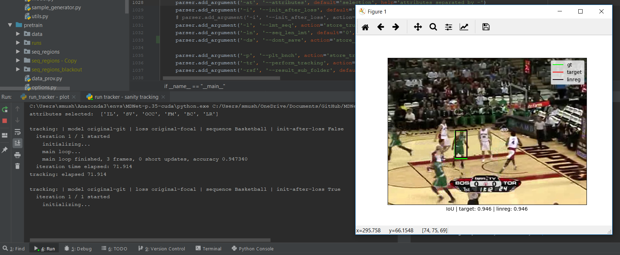
Object tracking benchmarks
Toolkits
Notes:
Wanted to implement myself – so I did … (in python – making it integrated with my dev environment)
My toolkit provides flexibility to:
Select sequences (can combine datasets)
Select metrics (from different benchmarks)
Limit number of frames
Control number of average cycles (required since MDNet is stochastic…) – e.g. I’m not bound to declared 15 averaging cycles of the VOT benchmark
Re-initialize (after loss) mode, or not

Slide 8
MDNet

Slide 9
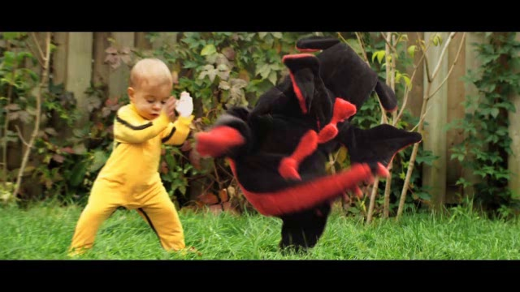
MDNet (Nam et al.)
background
Classification:
MDNet
object
Notes:
Basically, the MDNet network classifies a cropped images into either background or object

Slide 10
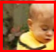
MDNet (Nam et al.)
background
Classification:
0.34
MDNet
0.82
object
Notes:
How to use:
Given frame → Suggest bounding box → Crop image per suggestion → give MDNet to classify to either background / object

Slide 11
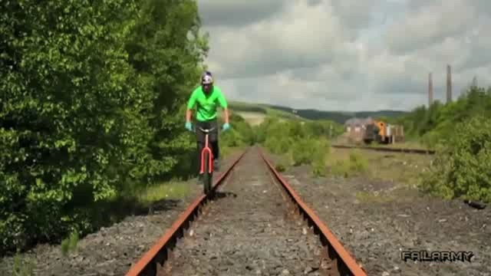
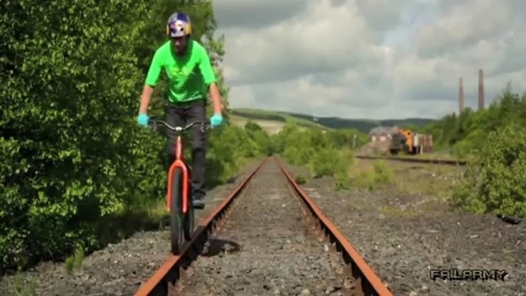
MDNet (Nam et al.)
Tracking routine:
Notes:
For each frame, need to suggest a BB (bounding box)

Slide 12
MDNet (Nam et al.)
Tracking routine:
Notes:
Generate random variations (aka “sample”) of BB[i-1] – in position and size

Slide 13
MDNet (Nam et al.)
Tracking routine:
Notes:
Select samples with highest “object” class scores (opposed to “background” class score)

Slide 14
MDNet (Nam et al.)
Tracking routine:
Notes:
average their coordinates of selected (highest scoring) samples

Slide 15
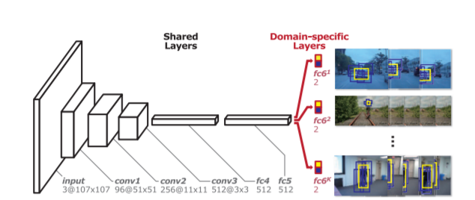
MDNet (Nam et al.)
Architecture
Extract features
Attempt lock on object
Classify
Notes:
CONV – is ZFNet pre-trained on ImageNet

Slide 16
Linear regression
For tracking refinement

Slide 17
MDNet refinement
Initialization
Ridge regression
Random “samples” around GT @ frame[0]

Slide 18
MDNet refinement
Runtime:
Notes:
MDNet uses Ridge regression to improve BB guess for each frame

Slide 19
MDNet refinement
Runtime:
Notes:
Input 1: BB coordinates

Slide 20
MDNet refinement
Runtime:
Notes:
Input 2: features extracted from crop per BB (via CONV)

Slide 21
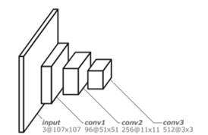
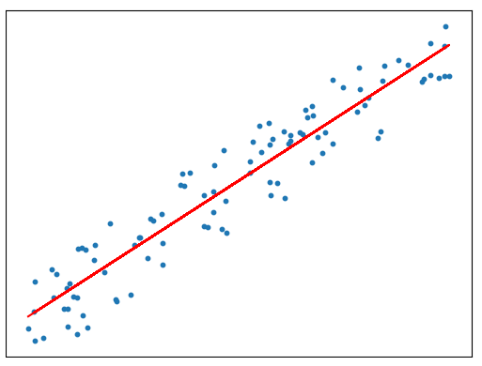
MDNet refinement
Runtime:
Notes:
Input 2: features extracted from crop per BB (via CONV)

Slide 22
MDNet refinement
Runtime:
Notes:
Output: Refined BB coordinates

Slide 23
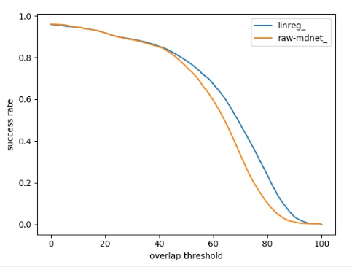
MDNet refinement
Ridge improves MDNet OTB benchmark
Notes:
We see slight advantage to linear regression
Benchmark was calculated on a subset of the OTB-50 dataset

Slide 24
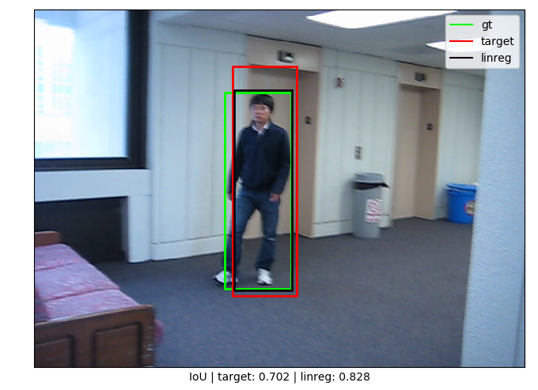
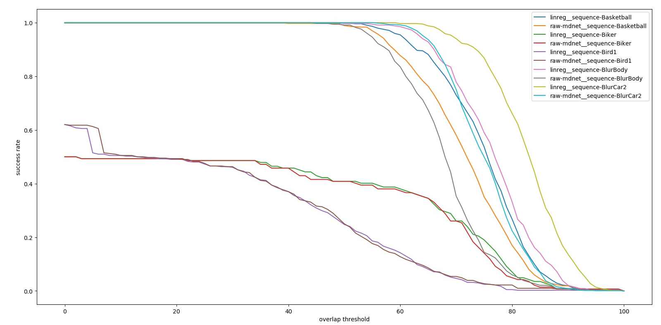
MDNet refinement
Success example
Notes:
e.g. BlurBody – seems like MDNet (without Ridge) “prefers” a straight frame for the object, e.g. the elevator lintel in this example
The Ridge regression corrects this
Maybe the blurness contributes to the MDNet having hard time finding proper object frame

Slide 25
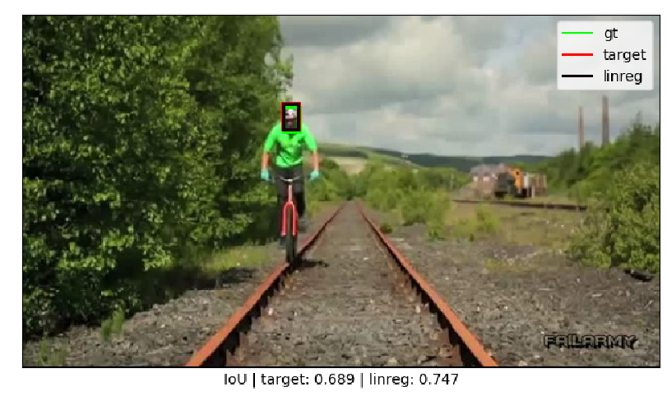
MDNet refinement
Failure example
Notes:
Init frame very small and low resolution
At this low res, any deviation from GT is substantial, hard to go over IoU 0.8

Slide 26
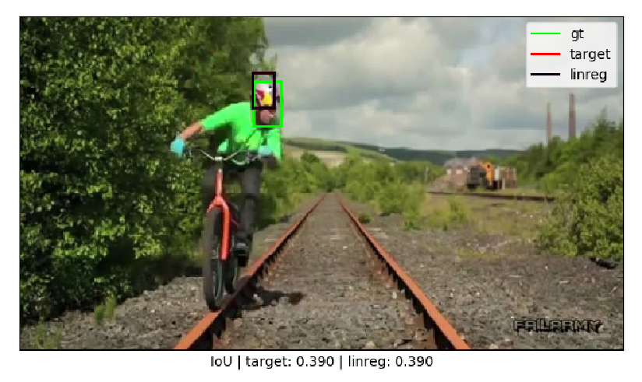
MDNet refinement
Failure example
Notes:
When target comes near camera, both MDNet and LinReg are ineffective
MDNet – because the colorful helmet looks more of an object then face + helmet
LinReg – because it was trained on Frame-0 which where the target was very small and low-res, so instead of tracking face+helmet, it tracks only helmet

Slide 27
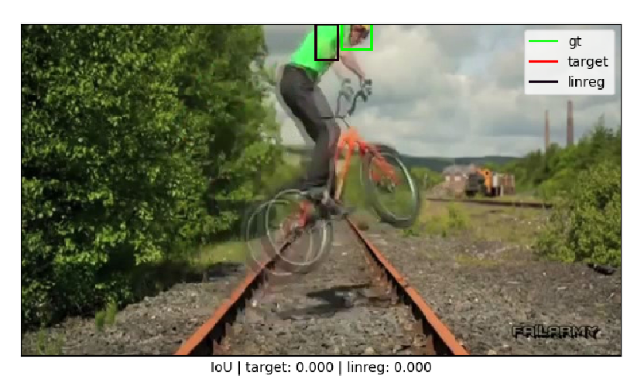
MDNet refinement
Notes:
Even when IoU constraint is loosened entirely, since half the sequence the object is actually lost, the success rate remains low
Obviously this is a result from running without re-initialization upon loss of track

Slide 28
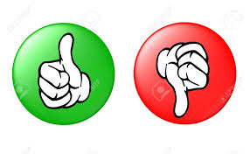
MDNet refinement
specialize in specific (given) target
delays start of tracking
sensitive to appearance variations

Slide 29
RegNet
For Tracking Refinement

Slide 30



LinReg (before)
LinReg
Notes:
Actually it’s the features of the crop that’s fed to the linear regression, not the actual bitmap

Slide 31
RegNet (after)
RegNet
Notes:
This was my motivation to do something else
Did not make sense to try refine BB without having the full frame

Slide 32
RegNet
Goal: tracking refinement
 | Ridge regression | RegNet
Specializes in | Object @ Frame[0] | Any object
Training stage | Frame[0] | Offline
Training time | < Second | Hours
Input | BB | BB + Frame
Depth | Linear | Deep
MDNet-specific | No | No
Notes:
I also wanted to see what could be achieved without using GT @ frame[0]
I decided to build my own network

Slide 33
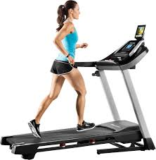
RegNet
Training routine
Random iterations
IoU samples > 0
Notes:
Training routine
Iterate randomly over multiple sequences
Iterate randomly over frames
For each frame generate “random samples” around ground-truth
Taking only samples with IoU > 0
Teach RegNet to refine samples, loss w.r.t ground-truth
Model precision measured in average IoU w.r.t ground-truths

Slide 34
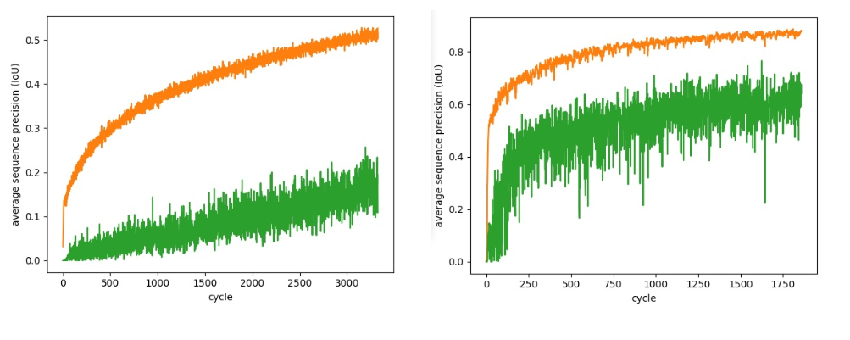
RegNet
Effects of learning rate:
lr = 1e-7
lr = 1e-4
Hidden Slide

Slide 35

RegNet
Performance acceleration - pre-generate samples
One-time effort
x5 improvement [cycle/sec]
Notes:
Performance acceleration – pre-generate samples
→ One-time effort to generate samples – generated e.g. 32 random samples for each frame
Training routine accelerated x 3 ~ 7
~ No change in convergence rate, i.e. number cycles required to achieve specific “real” training precision (measured with fresh samples from training dataset)

Slide 36
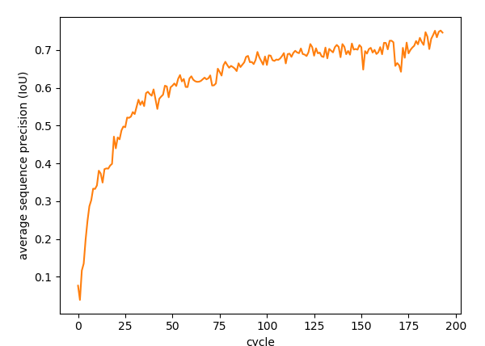
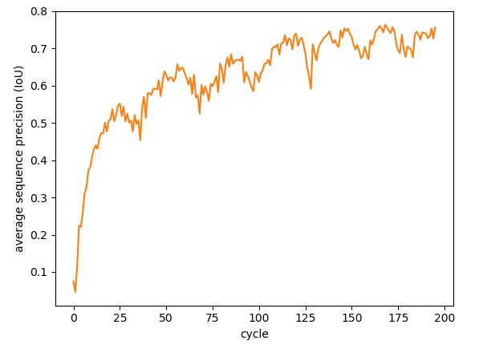
RegNet
Precision(#cycles)
Hidden Slide
before
after
Notes:
Left – online-generated samples
Right – pre-generated samples – seams a bit less stable
Network is 250-250 internal layers, working on 10 sequences, limited with 16 frames per sequences
This is a demonstration of convergence rate

Slide 37
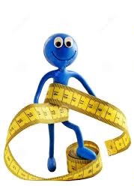
RegNet
Save memory - sequence sub-sampling
→ Adjacent frames are correlated
Hidden Slide
Notes:
save in memory - half as many frame needed
motivation: adjacent frames are correlated
So we train on every second frame (throw away odd indexed frames)
Training precision penalty / overfit is 0.02 ~ 0.04 in IoU terms - Penalty calculated by measuring precision on adjacent (discarded) frames
Training time did not increase substantially

Slide 38
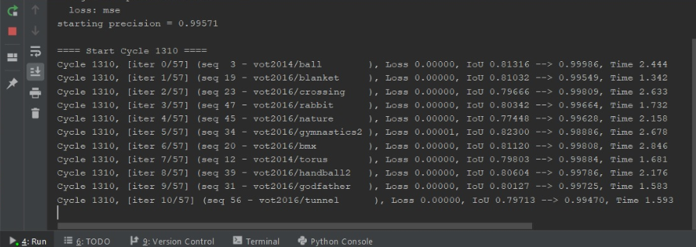
RegNet
cute bug
→ Training precision too perfect
Hidden Slide

Slide 39

RegNet
cute bug
→ Training precision too perfect
→ Testing showed NN doesn’t change input
Hidden Slide

Slide 40
RegNet
cute bug
→ Training precision too perfect
→ Testing showed NN doesn’t change input
→ Bug found! Trained to refine GT (instead of “samples”)
Hidden Slide

Slide 41
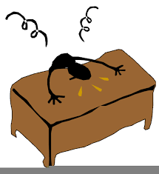
RegNet
cute bug
→ Training precision too perfect
→ Testing showed NN doesn’t change input
→ Bug found! Trained to refine GT (instead of “samples”)
Hidden Slide

Slide 42
RegNet
Overfit

Slide 43
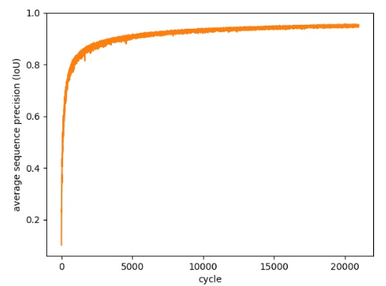
RegNet
Overfit
Training precision ~ 0.97
Real training precision ~ 0.88
Validation precision ~ 0.5
Notes:
Model with 4000-2000 internal layers, trained over 45 sequences from VOT with pre-generated samples
Graph shows the training precision computed on-the-fly, which is a bit higher than what we would get on newly generated samples from same sequences (i.e. 0.88 training precision…)
Validation precision was checked on image sets from VOT (last 15 sequences)
BTW this kind of precision currently takes about ~ half a day of training, give or take (i7, 1080)

Slide 44
RegNet
Overfit
Network size effectiveness diminishes
Training net-size | 50-50 | 250-250 | 4000-500 | 4000-500-50
Training precision | 0.9 | 0.9 | 0.91 | 0.89
Validation precision | 0.16 | 0.38 | 0.45 | 0.46
Notes:
Trained on first 30 sequences from VOT dataset with pre-generated data
Training precision measured on newly generated samples from given training sequences

Slide 45
RegNet
Overfit
Indifferent to dataset size / source
Training dataset size | 30 | 45 | 60
Training precision | 0.89 | 0.88 | 0.89
Validation precision | 0.49 | 0.5 | 0.49
Notes:
Model with 4000-2000 internal layers, trained with pre-generated samples
Training precision measured on newly generated samples from given training sequences
Here validation set was last 25 sequences of OTB (in other slides where I show OTB benchmark graphs I usually produce it after testing on the first 25 sequences of OTB)

Slide 46
RegNet
Overfit
Still not reached ~ 0.7
Training dataset size | 30 | 45 | 60
Training precision | 0.89 | 0.88 | 0.89
Validation precision | 0.49 | 0.5 | 0.49

Slide 47
RegNet
Overfit
Trying to understand how bad is the validation precision
Hidden Slide
0
total IoU (avg:std): (0.16998:0.05876) --> (0.32928:0.20709)
total IoU (avg:std): (0.46773:0.13368) --> (0.55199:0.18020)
total IoU (avg:std): (0.79735:0.02896) --> (0.70021:0.17217)
1
Notes:
I decomposed the validation precision (IoU) by limiting the IoU values of the input samples
It seems that there’s significant (relative) improvement on low IoUs

Slide 48
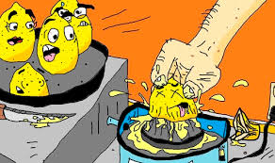
RegNet
Overfit
Can we make lemonade with low precision ?
Hidden Slide
0
total IoU (avg:std): (0.16998:0.05876) --> (0.32928:0.20709)
total IoU (avg:std): (0.46773:0.13368) --> (0.55199:0.18020)
total IoU (avg:std): (0.79735:0.02896) --> (0.70021:0.17217)
1
Notes:
Can we make lemonade from lower IoUs ?

Slide 49
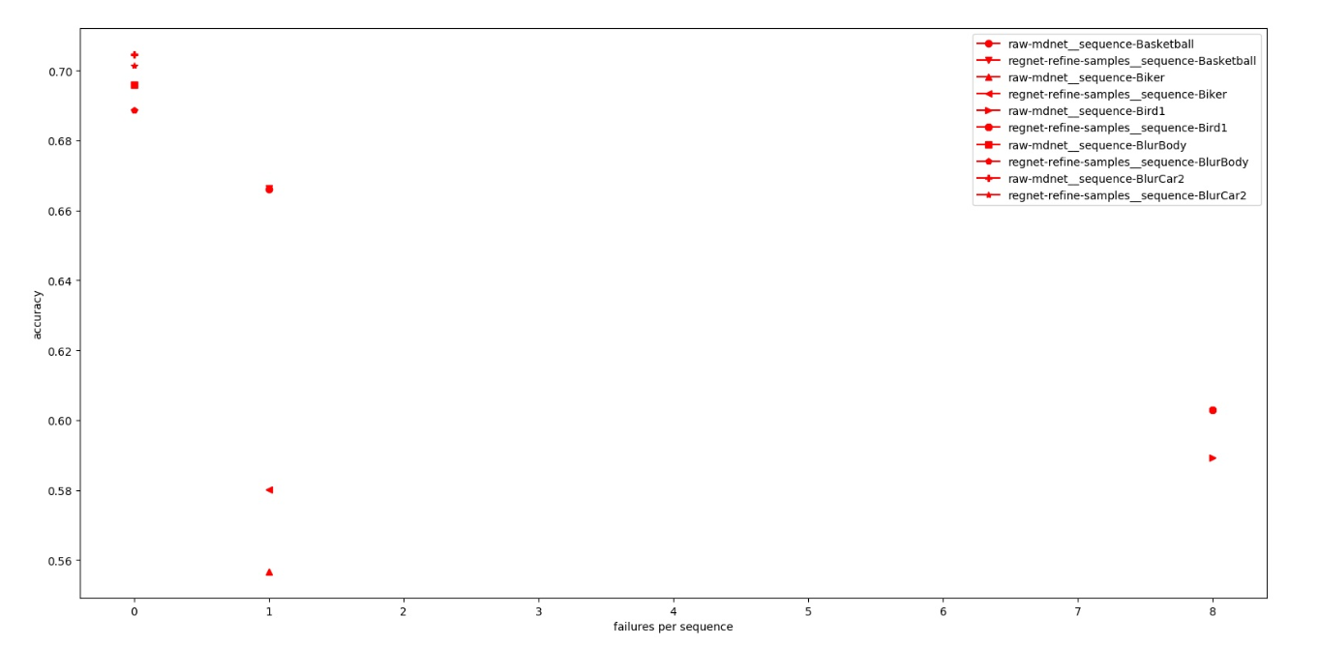
RegNet
Overfit – low precision lemonade
Attempt to use RegNet not for refining MDNet’s top samples, but refining ALL of samples BEFORE MDNet scoring
Small effects observed, more significant when MDNet looses track
Hidden Slide
Notes:
I took the 256 samples generated each frame, and passed them through RegNet
Now let MDNet pick the top-5 out of 512 instead of 256
Should improve by-definition (assuming MDNet object classification score does the job)
If this sanity check passes – we can do a “fairer” comparison, i.e. original 256 samples vs 128 + 128 transformed
Note: number of failures (X-axis) was not normalized e.g. per 100 frames
Improvement seems more significant in cases of lost track, this phenomena also appears on other sequences
Still, it is very small, < 0.2 %
So this is discarded
Note some cases of decreased performance, this is when MDNet scores make mistakes, giving higher score to worse samples (lower IoU with GT)

Slide 50
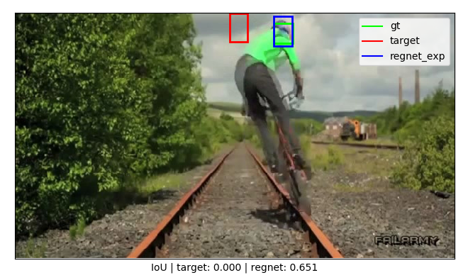
RegNet
Overfit – low precision lemonade
→ Effect may be real
Hidden Slide

Slide 51
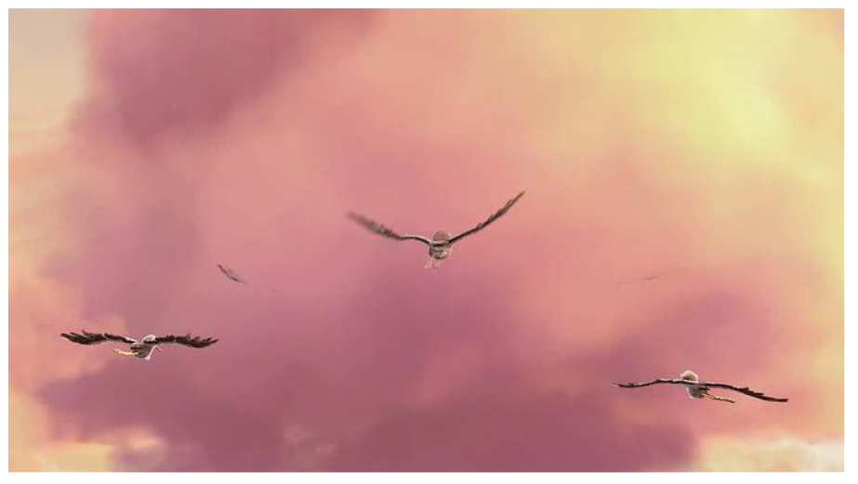

RegNet
Overfit – low precision lemonade
→ Effect may also be bad data
Hidden Slide
Notes:
Improvement by chance

Slide 52
RegNet
Overfit
Wait a minute…
Refining MDNet implies average input IoU ~ 0.6 (~0.7 minus Ridge)
Notes:
So basically MDNet needs to be taken as input to RegNet

Slide 53
RegNet
Overfit
Wait a minute…
Refining MDNet implies average input IoU ~ 0.6
Let’s check it:
Input average IoU | Validation precision
FULL (avg 0.4) | 0.49
MDNet (avg 0.69) | 0.68
HIGH (avg 0.86) | 0.74
Notes:
Note: I should have validated on a bit smaller average (more towards 0.6, i.e. MDNet without Ridge) but it’s really doesn’t matter much, still in the ballpark, I also did not address STD.
Still, it was good enough to make a decision if it’s time to go to testing.
Model trained on VOT-30
4000-2000 internal layers

Slide 54
RegNet
Overfit
Training on high IoU samples improves validation precision
Input average IoU | Traing on IoU full range 0-1 | Traing on IoU 0.75-1
FULL (avg 0.4) | 0.49 | 0.45
MDNet (avg 0.69) | 0.68 | 0.73
HIGH (avg 0.86) | 0.74 | 0.87
Notes:
Same model
I (accidently) used dropout 0.5 for the training of this high-IoU specialized model, but I don’t think it made any difference (since I also played with dropout separately and it did not show improvement in precision results)

Slide 55
RegNet
It’s Testing Time !

Slide 56
RegNet
High-IoU specialty
→ We hit ballpark !
→ Still not as good as Ridge ?
 | MDNet | MDNet + Ridge | MDNet + RegNet
Test accuracy (OTB) | 0.643 | 0.685 | 0.651
Notes:
Took same RegNet model from previous slide – trained on VOT-30 dataset and tested on OTB dataset
On first look, it seems Ridge is leading
Accuracy is the same as precision
Accuracy is a term from VOT benchmark

Slide 57
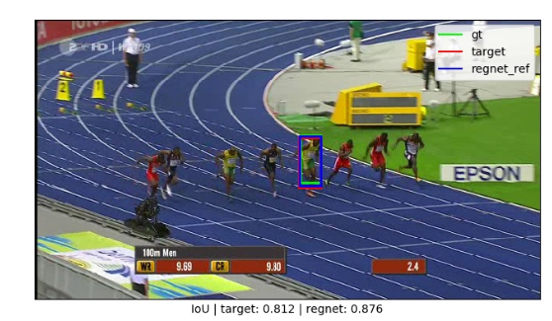
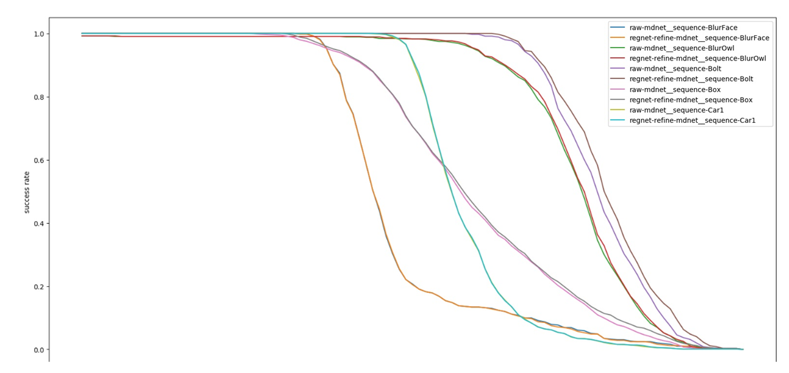
RegNet
High-IoU specialty
RegNet does not hurt MDNet performance
When object detected will not attempt to refine
MDNet vs MDNet+RegNet
Notes:
RegNet actually performs really well in detecting objects – when given as input the “target” (i.e. raw MDNet without Ridge) it recognizes it as object and does not attempt to refine

Slide 58
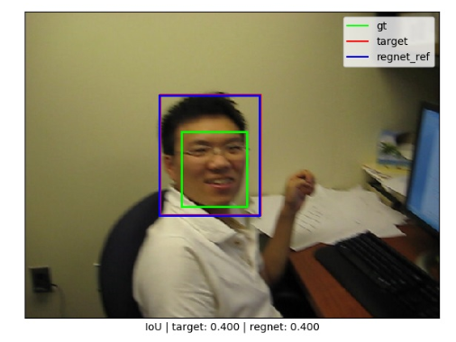
RegNet
High-IoU specialty
Are we really “worse” than Ridge ? (per the benchmark – yes)
But maybe even “more correct” ?
MDNet vs MDNet+RegNet
Notes:
Note how low the BlurFace performance was scored
On the other hand, the small improvement on Bolt sequence really looks meaningless…

Slide 59
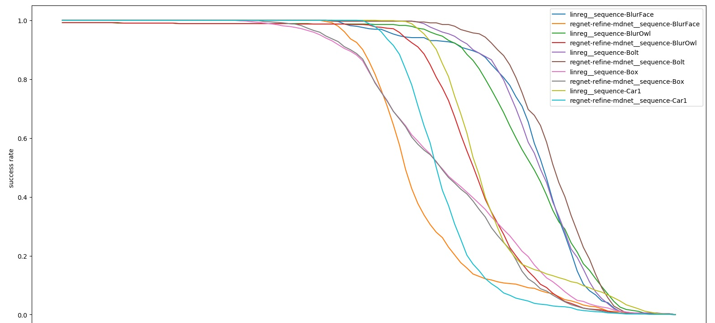
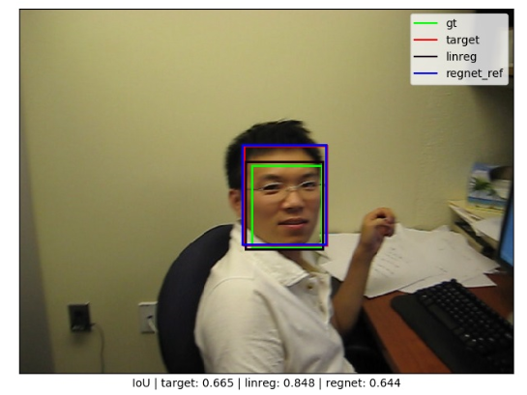
RegNet
High-IoU specialty
Ridge is better at benchmark because of Frame[0]
Not necessarily better “objectively” …
MDNet+Ridge vs MDNet+RegNet
Notes:
Same sequence – ridge regression scores much better for the benchmark
Remember Ridge regression “specialized” in “hairless face” using frame0
This means that the apparent better accuracy that Ridge has over RegNet is totally artificial and very benchmark-specific (OTB).

Slide 60
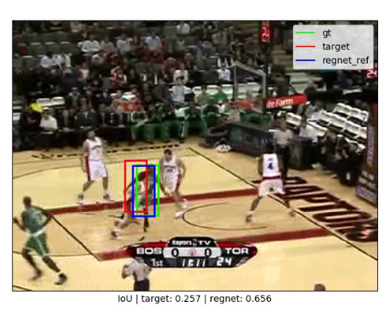
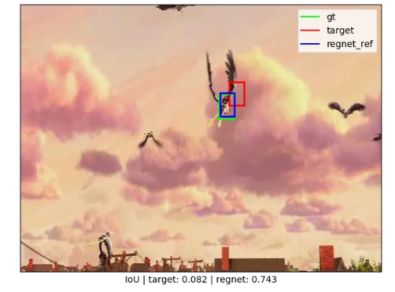
RegNet
High-IoU specialty
→ RegNet is not degenerated
→ It will perform real refinements when needed
Notes:
Now, just to show that RegNet don’t just follow the input but can actually improve bad BB
I will first remind that during training it actually achieved large improvement over input, so it’s not zero weights
But I want to demonstrate this visually.
Mostly, RegNet will follow the input it got from MDNet
Sometimes, it will bright up and show how it can correct for better objectiveness
In these examples. I forced MDNet to generate less samples around the previous BB so it naturally losses tracking ability (lower IoU) giving RegNet opportunity to shine.
Here are select examples where it did

Slide 61
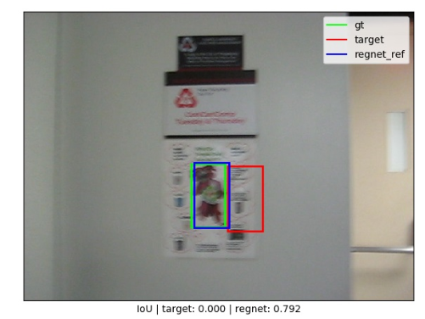
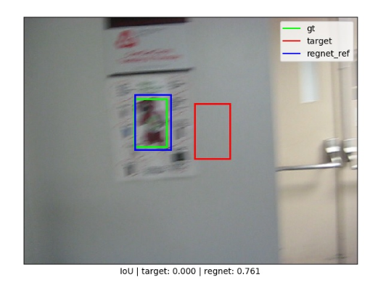
RegNet
High-IoU specialty
→ RegNet can “jump” to object
Notes:
A few more
Showing RegNet can even “jump distance” even though it was trained on positive IoU only

Slide 62
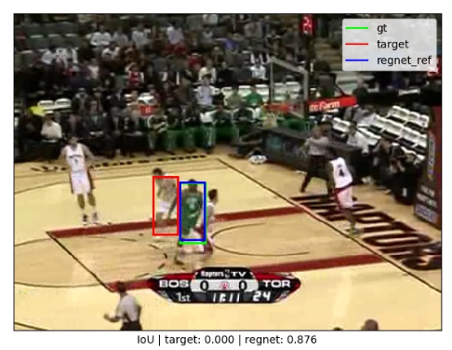
RegNet
High-IoU specialty
→ RegNet can “jump” between objects
Notes:
Lastly my favorite, jumping from one object to another, probably because it has better “objectiveness”

Slide 63
RegNet
Hidden Slide
Fails

Slide 64
RegNet
Fails
- Using GT @ frame[0]
Hidden Slide
Notes:
I attempted to retrain the specialized network on frame0 of BlurFace in an attempt to improve benchmark performance
I gave it ~ 1 minute until the precision graph flattened
It did nothing to improve, i.e. to track GT specifically and not another object candidate
Also it did not seam to improve the (in-)ability of RegNet to track independently, i.e. without MDNet.
At the very least the first condition should probably be higher fps.

Slide 65
RegNet
Fails
Using dropout (0.5) to improve validation precision – it did not
Crop without resize – instead blackout the pixels around the BB – did not improve precision
Work directly on standard size images for acceleration – loss of accuracy for small acceleration
Did not explore much, initial results were not promising –
Output as absolute coordinates -- instead of [x, y, w, h] translation
Size & center-distance Loss -- instead of coordinates-distances (MSE)
SGD -- instead of Adam
L1Loss -- instead of MSELoss
Hidden Slide
Notes:
Work directly on standard size images - Generate samples is STD size, do precision calculations in STD size – avoid resizing – model was less accurate (much larger variance in training curve) for just 15% acceleration in training time

Slide 66
RegNet
Quadrilateral Generalization

Slide 67
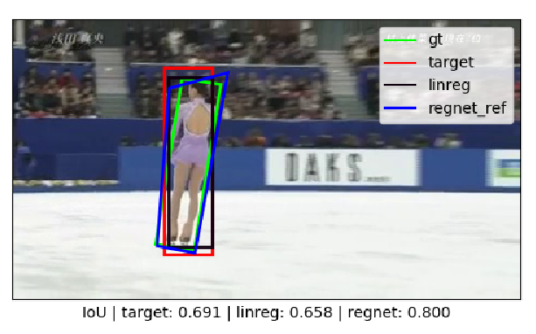
RegNet
Quadrilateral
Notes:
Here I demonstrate using RegNet 8 outputs allowing any quadrilateral
Remember VOT allows GT as rotated rectangles, I generalized it to any quadrilateral
It’s not compatible with the VOT benchmark (which is explicitly rotated rectangles) but it’s cool !!
Obviously, it’s cheating because the network was trained on this specific sequence, but it’s just a demonstration
I took 4000-2000 network (internal layers), no dropout, trained it on iceskater1 sequence with 0.75-1 IoU samples range.

Slide 68
RegNet
Summary
Hidden Slide
Notes:
Worked on this for 2~3 accumulated
First real practice of deep learning
Trained a model that can identify and “lock on” objects nearby given bounding box
Not built to win a benchmark which gives specific object which in some scenes may look “less of an object” compared with near-by ones

Slide 69
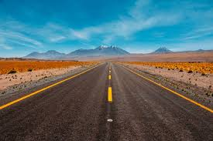
RegNet
What more can we try ?
Fundamental
Net size, depth
ConvNet
Clean data
MDNet-specific
Online training
Enhancements
Rotated BB
Input previous frame(s) / Projection
Self-track on high-fps sequences
Notes:
More ideas for future:
Size/depth - RegNet is already ~ 500 MB in size (9220-4000-2000-4), not much room to grow (MDNet is 17 MB including FC 4608-512-512-2 and CONV layers…)
ConvNet – try convolutional layers instead of fully connected
Clean data – e.g. remove frame where you can’t see the target (birds in cloud), e.g. remove frames where target is truncated by frame, etc.
Online training - repurpose MDNet FC to ALSO do the regression (on top of classification), thus also enjoy the online training routine
Rotated BB - Allow RegNet to receive and more importantly to produce rotated bounding boxes for a tighter fit to object. So it can enhance models trained on non-rotated BB
Input previous frame(s) – this means RegNet will no longer be based on object detection, but will also be able to track changes. This is an alternative to the idea of online training to specialize in new object appearance.

Slide 70
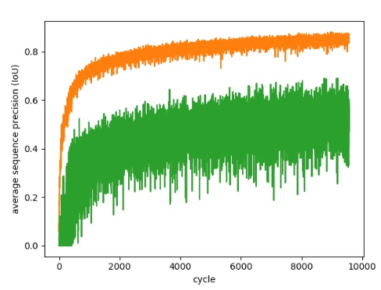
RegNet
Average vs. worst precision
Should we clean data ?
Will it improve learning ?
Hidden Slide
Notes:
Most sequences are close to the mean
A few outliers “drag” the precision down, could be up to 0.1 …
These may be e.g. where occlusions occur – so you can’t really train a network to find objects…

Slide 71
Questions ?

